Slide 1

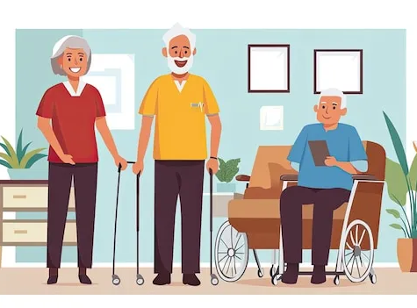
Elderly Care Management System(ECMS) – Yr 4 Project
By Qadeer Hussain
Supervisor: Paul Barry
Date: 25/10/2024

Slide 2
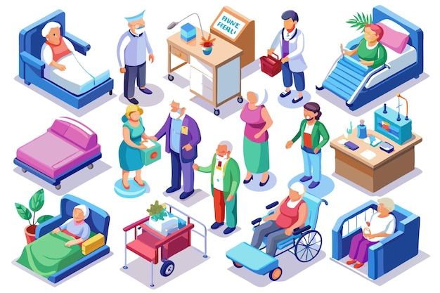
The ECMS Project
The emphasis of this project is to create a secure application which confines to the HL7 storage and encryption standard
The creation of this application will help alleviate and modernize patient data management replacing documentation with a digital system

Slide 3
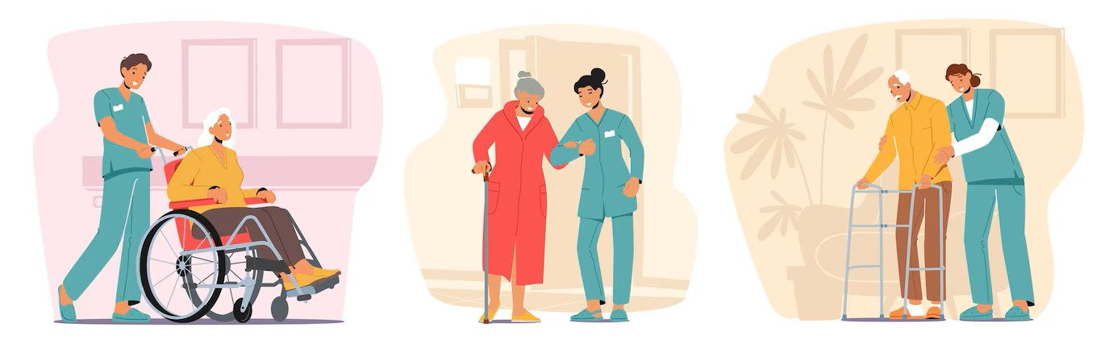
Who is it for
Care Home
Care Office Staff (Admin)
Carer’s

Slide 4
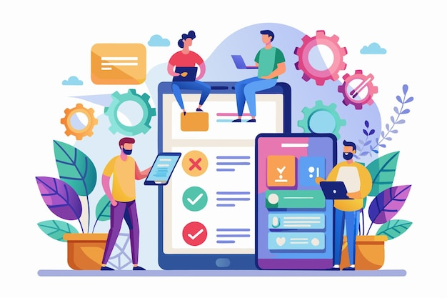
User Features
Login
Register
Patient Profile
Care Plan
Medical Dashboard
Roster
Incident Reporting
Alert

Slide 5
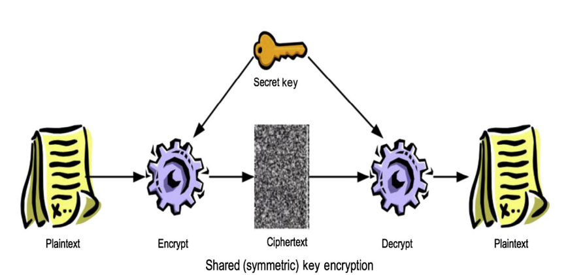
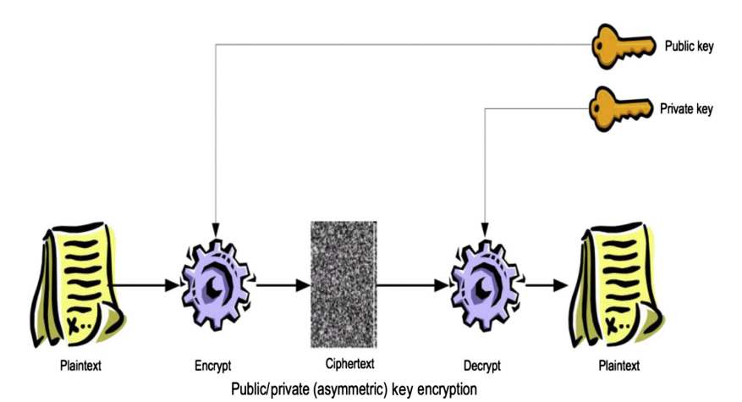

Backend Features
Health Level 7
Security (Cryptography)
Shared Key encryption
Public Key encryption

Slide 6



Technologies

Slide 7



Existing Systems

Slide 8
Potential Issues/Challenges
This will be a learning curve for me as I will get an opportunity to gain more knowledge about cryptography.
Adhering to the Health Level 7 Standards.
Time management to adhere to deadlines.

Slide 9

Thank you any Questions?

Slide 10
References
Pass by Everylife, 2024. Pass. [Online] Available at: https://www.everylifetechnologies.com/ [Accessed October 2024].
Nourish, 2024. Nourish. [Online] Available at: https://nourishcare.com/ [Accessed October 2024].
Log my Care, 2024. Log my Care. [Online] Available at: https://www.logmycare.co.uk/ [Accessed October 2024].
Health Level Seven International, 2024. Introduction to HL7 Standards. [Online] Available at: https://www.hl7.org/implement/standards/index.cfm?ref=nav [Accessed October 2024].
(2024a) Freepik | create great designs, faster.
Available at: https://www.freepik.com/
(Accessed: October 2024).
https://www.python.org/
https://www.djangoproject.com/
https://mariadb.org/
https://pypi.org/project/cryptography/

Slide 11

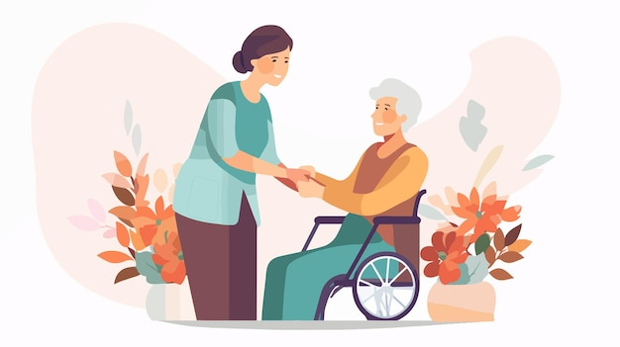


Elderly Care Management System – Yr 4 Project
-By Qadeer Hussain Date: 25/10/2024
What is the project?
It is a secure web application to safeguard and manage patient data in care centres.
Digital documentation to streamline workflow.
Application designed to cater Admin and Carer.
What is Health Level 7 (HL7)?
Framework for the exchange, integration, sharing and retrieval of health information.
Most used standard globally.
HL7 specifies several standards, guidelines and methodologies for health-related systems.
Existing Systems
Pass App
Log my Care
Nourish
Figure [1]
Technologies
Here are some possible technologies that could be used for example:
Python: https://www.python.org/
Django: https://www.djangoproject.com/
MariaDB: https://mariadb.org/
Cryptography lib: https://pypi.org/project/cryptography/
What is Shared Key and Public Key?
Shared key is a form of cryptography.
Also known as Symmetric encryption.
Method of encrypting data and decrypting data using one key.
Public key is a form of cryptography.
Also known a Asymmetric encryption.
Method of encrypting and decrypting data using two keys.
References
2024) Elderly care vectors & illustrations for free download | Freepik. Available at: https://www.freepik.com/vectors/elderly-care (Accessed: October 2024).
Health Level Seven International, 2024. Introduction to HL7 Standards. [Online]. Available at: https://www.hl7.org/implement/standards/index.cfm?ref=nav [Accessed October 2024].
ScienceDirect, 2017. Embedded security. [Online]. Available at: https://www.sciencedirect.com/topics/computer-science/shared-key-encryption [Accessed October 2024].
Augusto Vega, P. B. A. B., 2017. Rugged Embedded Systems. s.l.:Morgan Kaufmann.
Cryptography images – browse 869,371 stock photos, vectors, and video (2024) Adobe Stock. Available at: https://stock.adobe.com/search?k=cryptography (Accessed: October 2024).
(2024a) Healthcare System Images - free download on Freepik. Available at: https://www.freepik.com/free-photos-vectors/healthcare-system (Accessed: October 2024).
What are the Core features?
This is a list of features that will be included in this project:
Implementing Security
Patient Profile
Care Planner
Medical Dashboard
Roster
Figure [5]
Figure [6]
Figure [3]
Figure [3]

